Slide 1


Slide 2

Online Auto Mechanic Finder

Slide 3
Group Members Introduction
Name: Danish Saleem
VU ID: BC150403476

Slide 4

INTRODUCTION OF PROJECT
The auto mechanic finder is a web-based application.
This is a platform which will allow customers to find the auto-mechanic from different areas.
There will be three modules of this platform. One for the admin, second for the customers and third for auto mechanic respectively.
Register user can send request to mechanic and post feedback against mechanic.
Mechanics can view feedbacks and received request from users.

Slide 5
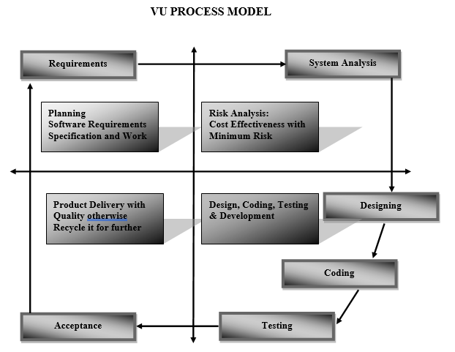

Slide 6
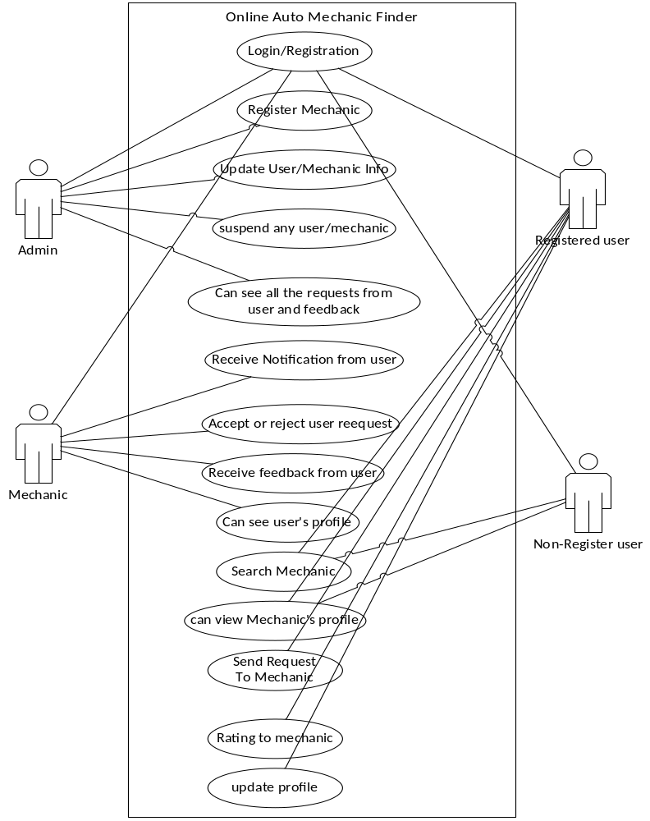
Use Case Diagram

Slide 7
Business Rules Catalog
User can search for the mechanic and see shop details on location base.
User can register on the system.
User can login on the system and send request to the mechanic.
User can post feedback regarding mechanic.
Mechanic can see the received requests, respond and view feedbacks regarding.

Slide 8
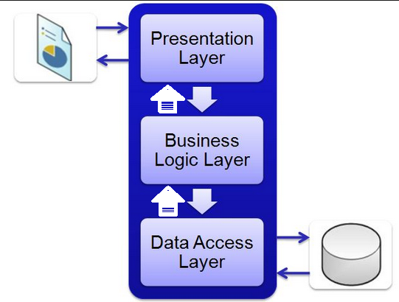
Architectural Design

Slide 9
Team Structure
Gathering Info
Testing
Planning
Danish Saleem
Development
Designing

Slide 10
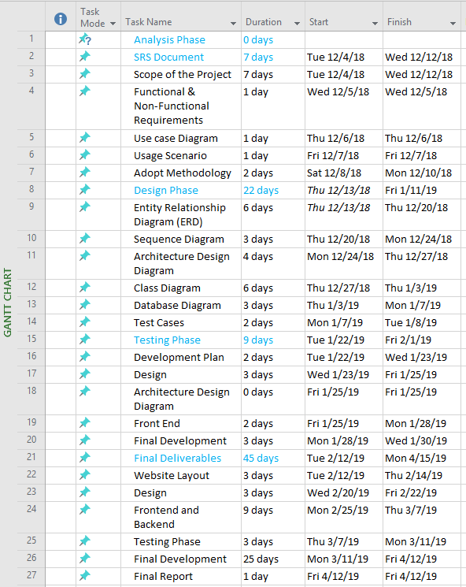
Project Schedule

Slide 11
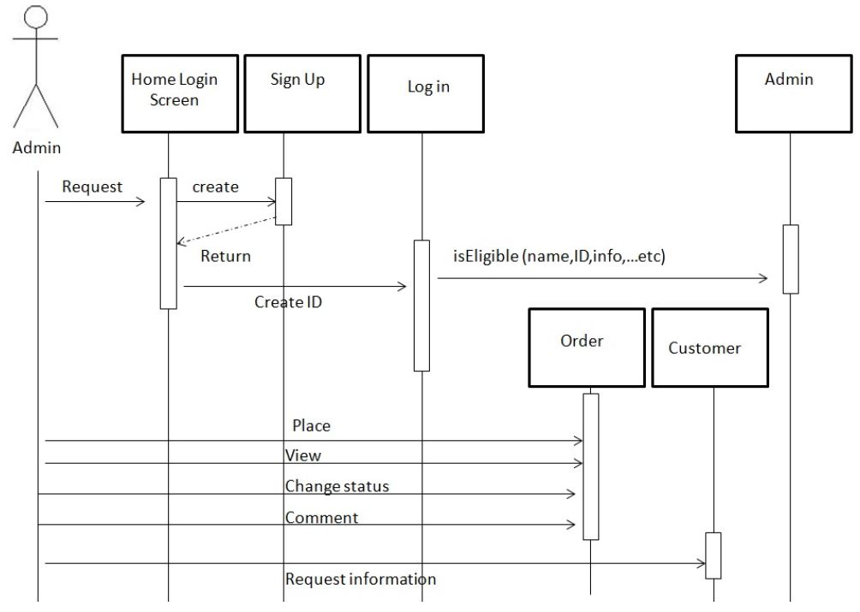
Sequence Diagrams

Slide 12
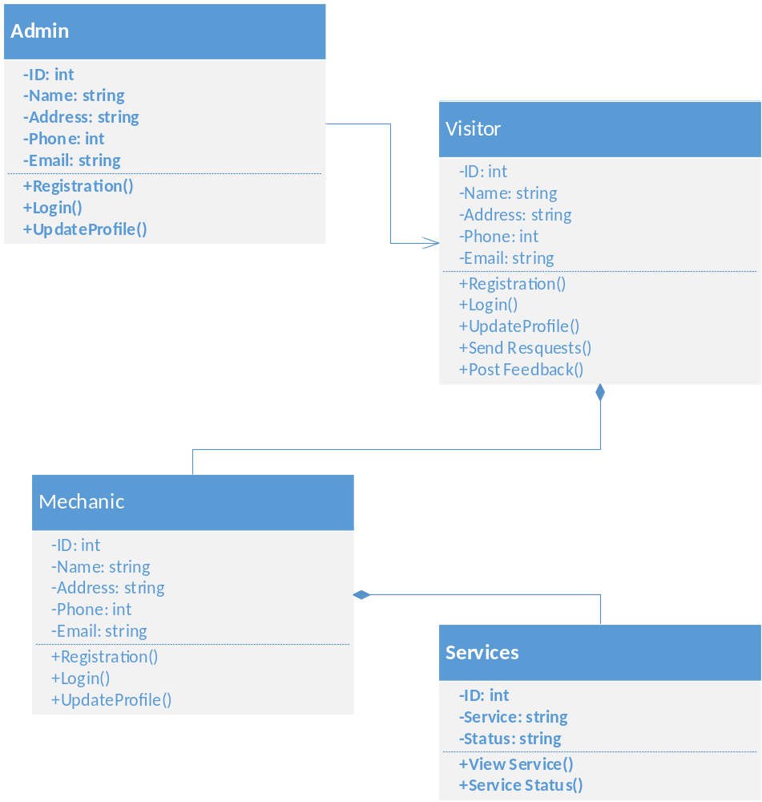
Logical Model/Class Diagram

Slide 13
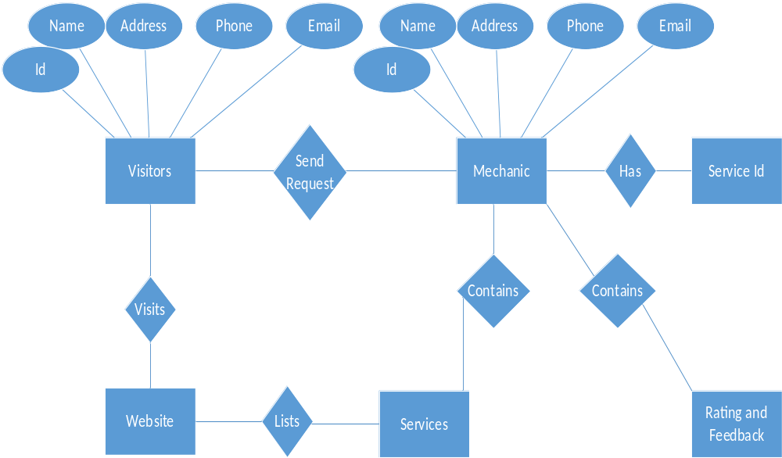
Entity-Relationship Diagram

Slide 14
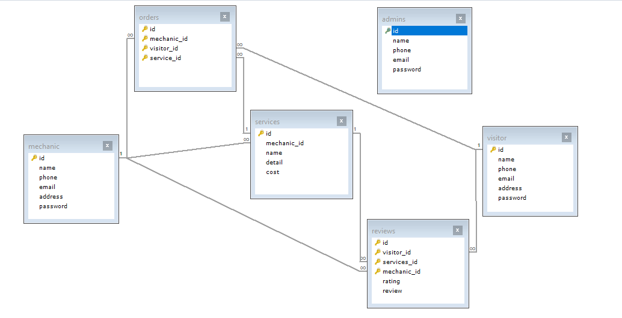
Database Diagram

Slide 15
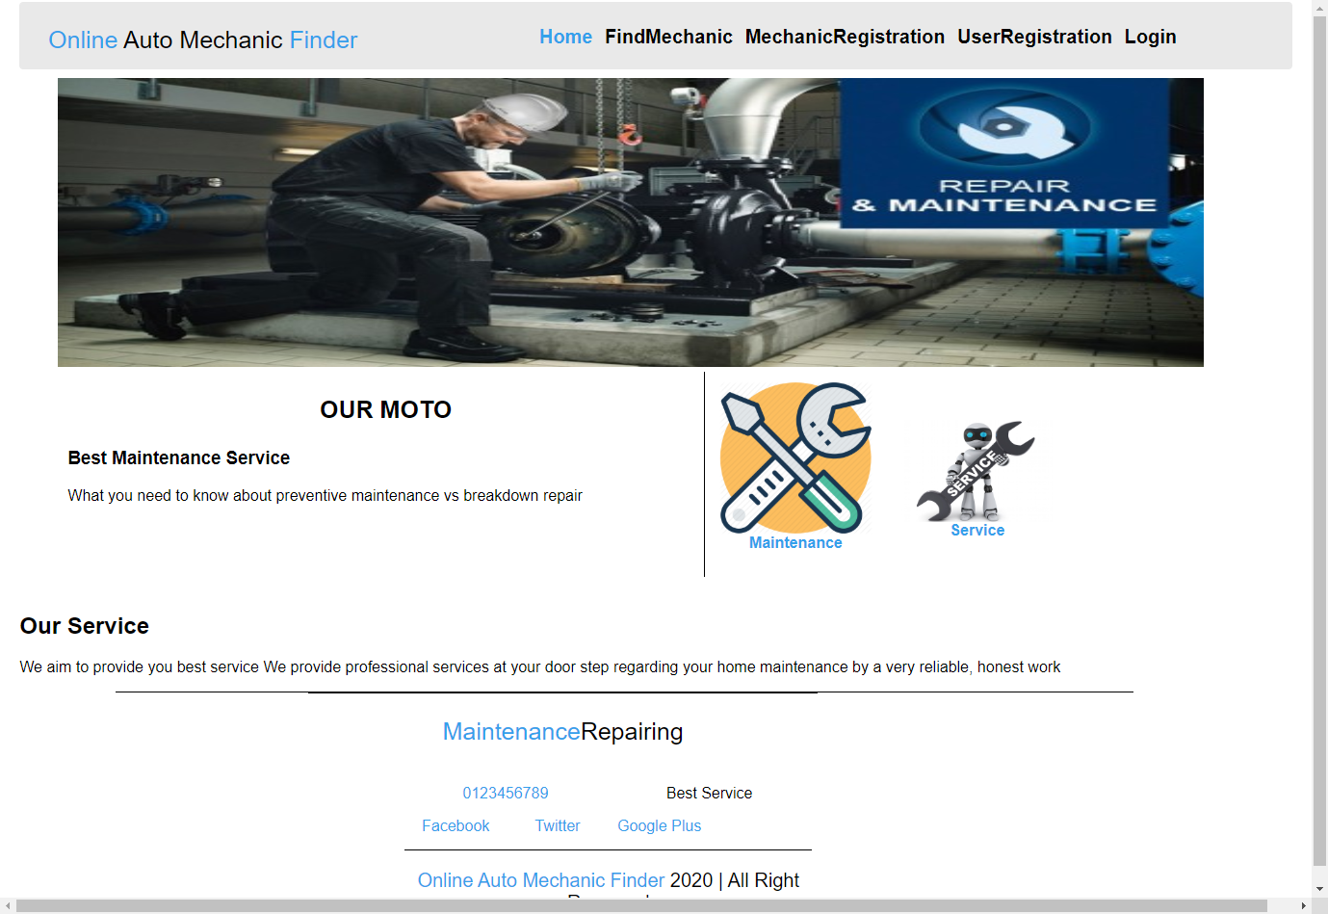
User Interfaces

Slide 16
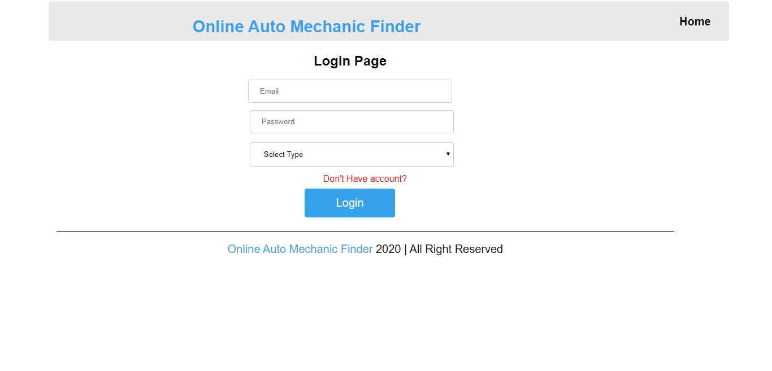
User Interfaces

Slide 17
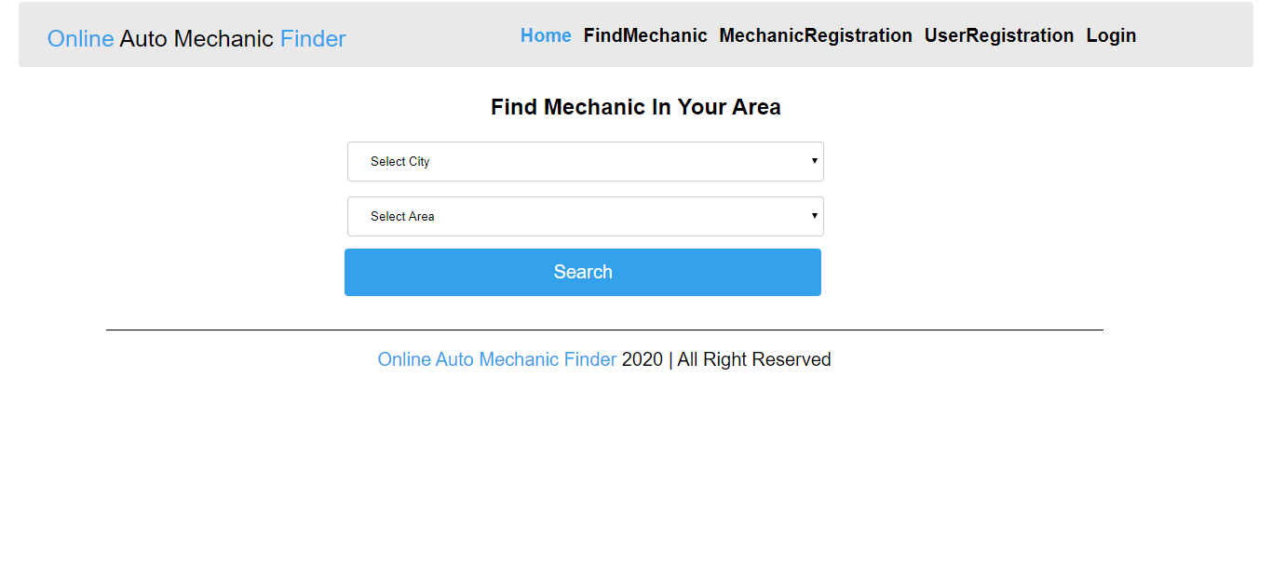
User Interfaces

Slide 18
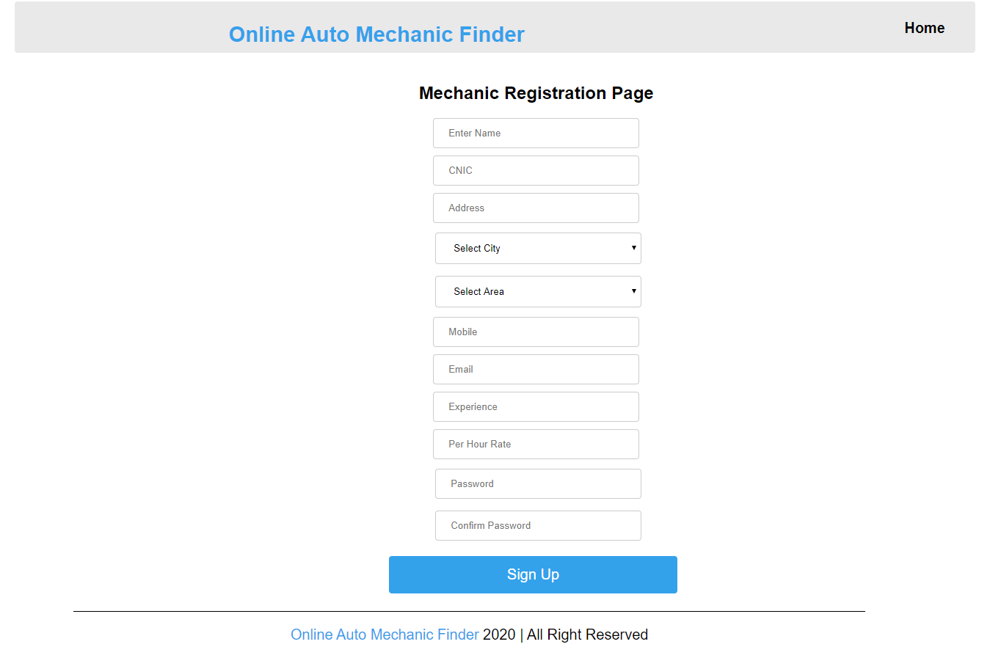
User Interfaces

Slide 19
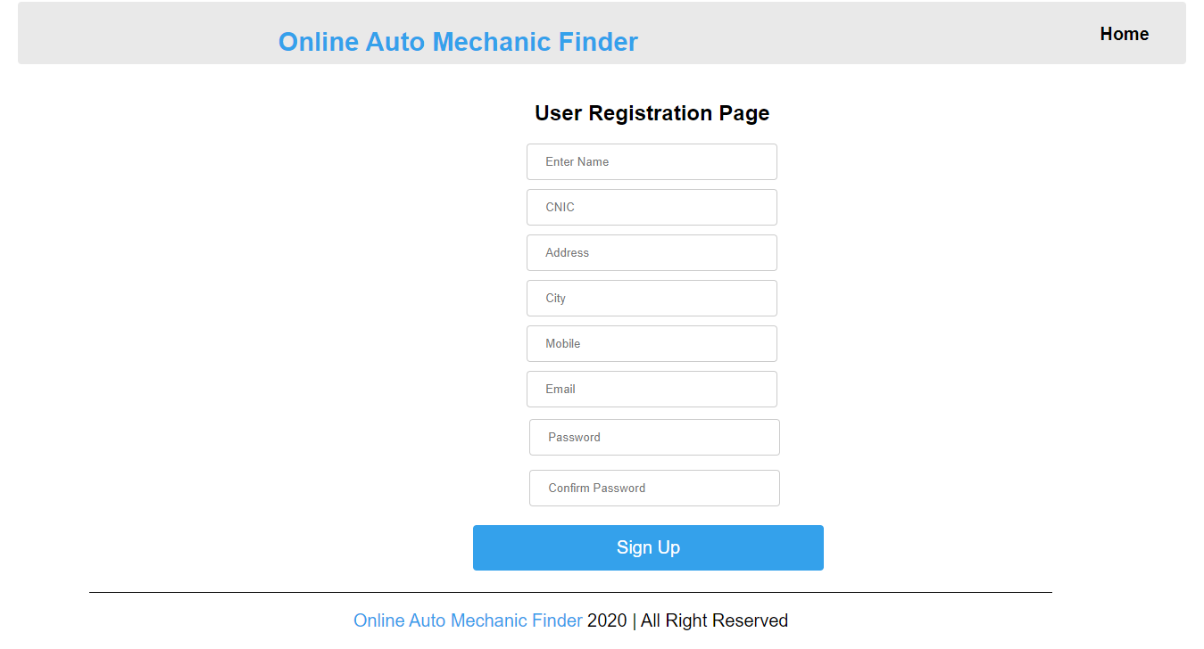
User Interfaces

Slide 20
Tools
XAMPP Server
HTML
CSS
JavaScript
PHP
MYSQL

